Slide 1

Introduction to Computer Science: Programming Methodology
Tutorial 2
DATA REPRESENTATION AND CONVERSION
Kaiyan ZHENG, FE
Sept. 11 2023
kaiyanzheng@link.cuhk.edu.cn

Slide 2
Outline
1.Data representation using positional notation.
Conversion from binary(2), octal(8) and hexadecimal(16) system to decimal(10) system.
2.Conversion from decimal system(10) to hexadecimal(16), octal(8) and binary(2) system.
i. Integer part.
ii. Fractional part.
3.One-to-one relationship between i) octal and binary system; ii) hexadecimal and binary system.

Slide 3
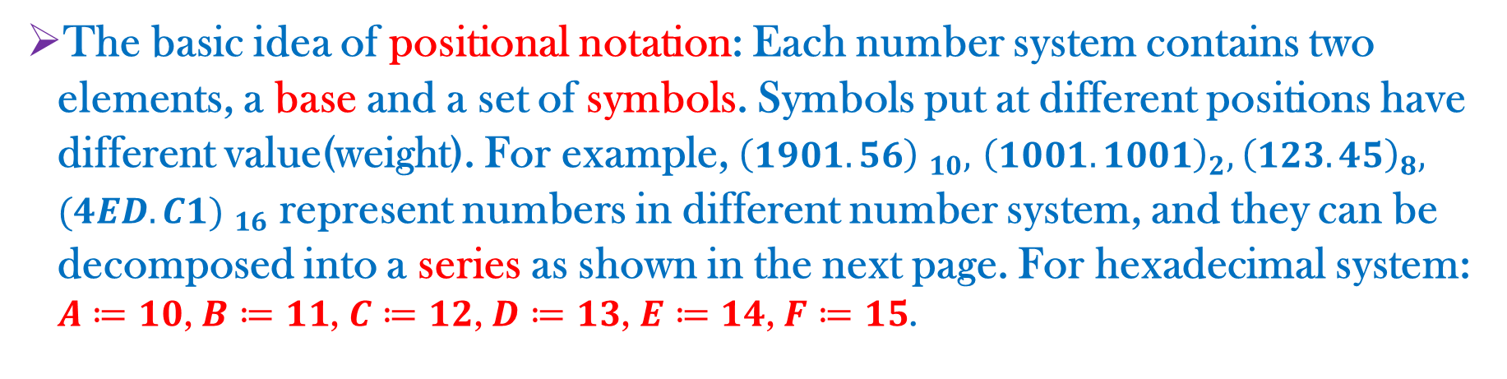
Number System
The basic idea of positional notation: Each number system contains two elements, a base and a set of symbols. Symbols put at different positions have different value(weight). For example, ${\left(1901.56\right) }_{10},$ ${\left(1001.1001\right)}_{2},$ ${\left(123.45\right)}_{8},$ ${(4ED.C1) }_{16}$ represent numbers in different number system, and they can be decomposed into a series as shown in the next page. For hexadecimal system: $A≔10$, $B≔11$, $C≔12$, $D≔13$, $E≔14$, $F≔15$.
Number system | Base | Set of symbols
Decimal system | 10 | 0,1,2,3,4,5,6,7,8,9
Binary system | 2 | 0,1
Octal system | 8 | 0,1,2,3,4,5,6,7
Hexadecimal system | 16 | 0,1,2,3,4,5,6,7,8,9,A,B,C,D,E,F

Slide 4
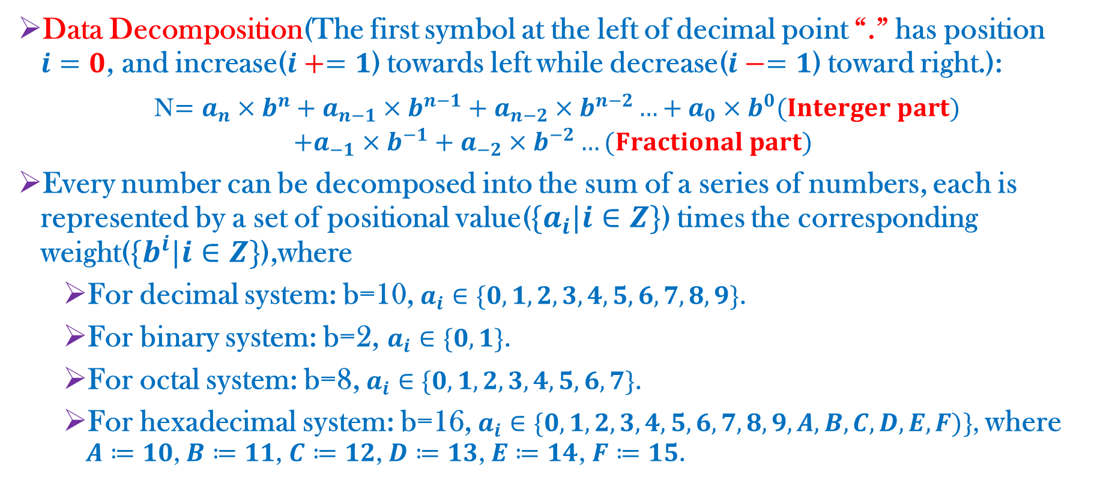
Data Representation
Data Decomposition(The first symbol at the left of decimal point “.” has position $i=0$, and increase($i+=1$) towards left while decrease($i−=1$) toward right.):
N$=a_{n}×b^{n}+a_{n−1}×b^{n−1}+a_{n−2}×b^{n−2}…+a_{0}×b^{0}(Interger part)$
$$+a_{−1}×b^{−1}+a_{−2}×b^{−2}…(Fractional part)$$
Every number can be decomposed into the sum of a series of numbers, each is represented by a set of positional value($\{a_{i}|i∈Z\}$) times the corresponding weight($\{b^{i}|i∈Z\}$),where
For decimal system: b=10, $a_{i}∈\{0,1,2,3,4,5,6,7,8,9\}$.
For binary system: b=2, $a_{i}∈\{0,1\}$.
For octal system: b=8, $a_{i}∈\{0,1,2,3,4,5,6,7\}$.
For hexadecimal system: b=16, $a_{i}∈\{0,1,2,3,4,5,6,7,8,9,A,B,C,D,E,F)\}$, where $A≔10$, $B≔11$, $C≔12$, $D≔13$, $E≔14$, $F≔15$.

Slide 5
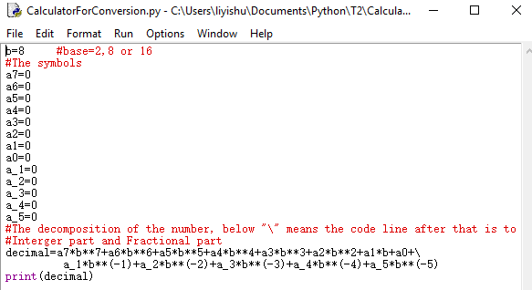
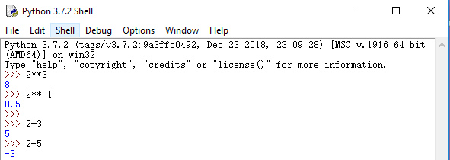
Use Python as calculator
In Python Shell, you could just type the computational formulas and press Enter, the result will be auto calculated and displayed.
Create a new py file, define different variables, do calculation for these variables, and print the result.

Slide 6
Practice 1
i) Binary number 100.1 equals to decimal number _________
ii) Octal number 100.1 equals to decimal number _________
iii) Hexadecimal number 100.1 equals to decimal number _________

Slide 7

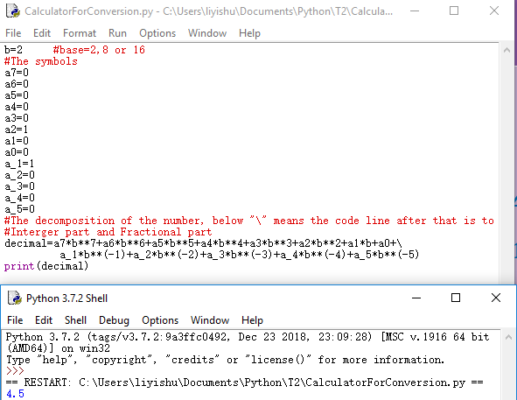
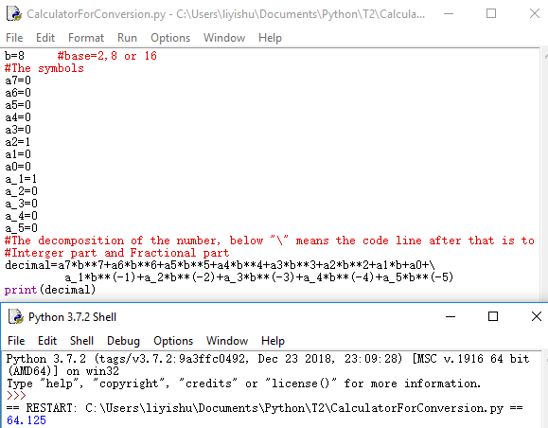

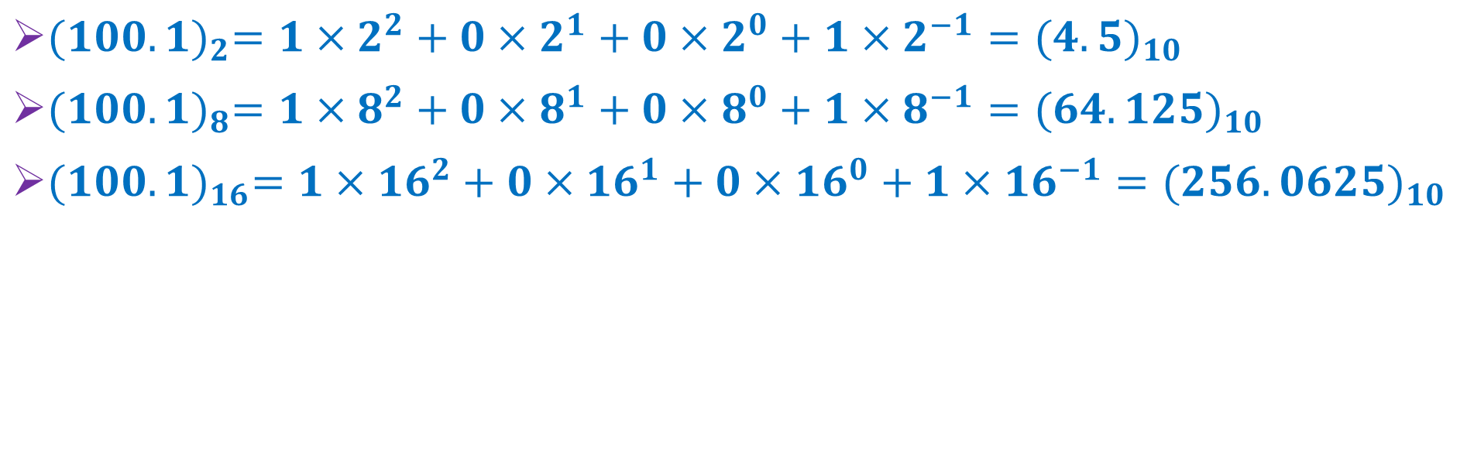
Solution
${(100.1)}_{2}=1×2^{2}+0×2^{1}+0×2^{0}+1×2^{−1}={(4.5)}_{10}$
${(100.1)}_{8}=1×8^{2}+0×8^{1}+0×8^{0}+1×8^{−1}={(64.125)}_{10}$
${(100.1)}_{16}=1×{16}^{2}+0×{16}^{1}+0×{16}^{0}+1×{16}^{−1}={(256.0625)}_{10}$

Slide 8
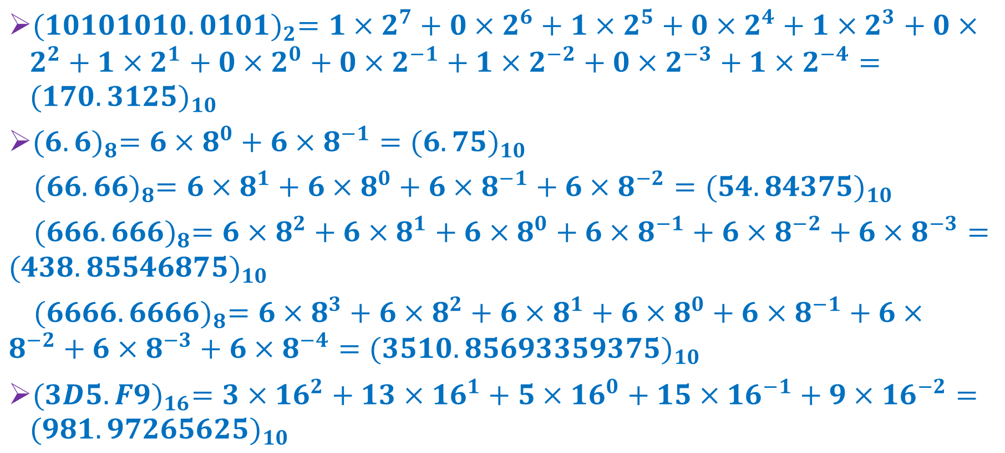
Solution
${(10101010.0101)}_{2}=1×2^{7}+0×2^{6}+1×2^{5}+0×2^{4}+1×2^{3}+0×2^{2}+1×2^{1}+0×2^{0}+0×2^{−1}+1×2^{−2}+0×2^{−3}+1×2^{−4}={(170.3125)}_{10}$
${(6.6)}_{8}=6×8^{0}+6×8^{−1}={(6.75)}_{10}$
${(66.66)}_{8}=6×8^{1}+6×8^{0}+6×8^{−1}+6×8^{−2}={(54.84375)}_{10}$
${(666.666)}_{8}=6×8^{2}+6×8^{1}+6×8^{0}+6×8^{−1}+6×8^{−2}+6×8^{−3}={(438.85546875)}_{10}$
${(6666.6666)}_{8}=6×8^{3}+6×8^{2}+6×8^{1}+6×8^{0}+6×8^{−1}+6×8^{−2}+6×8^{−3}+6×8^{−4}={(3510.85693359375)}_{10}$
${(3D5.F9)}_{16}=3×{16}^{2}+13×{16}^{1}+5×{16}^{0}+15×{16}^{−1}+9×{16}^{−2}={(981.97265625)}_{10}$

Slide 9
Practice 2
Convert binary number 10101010.0101 into decimal number.
Convert octal number 6.6, 66.66, 666.666, and 6666.6666 into decimal number.
Convert hexadecimal number 3D5.F9 into decimal number.

Slide 10
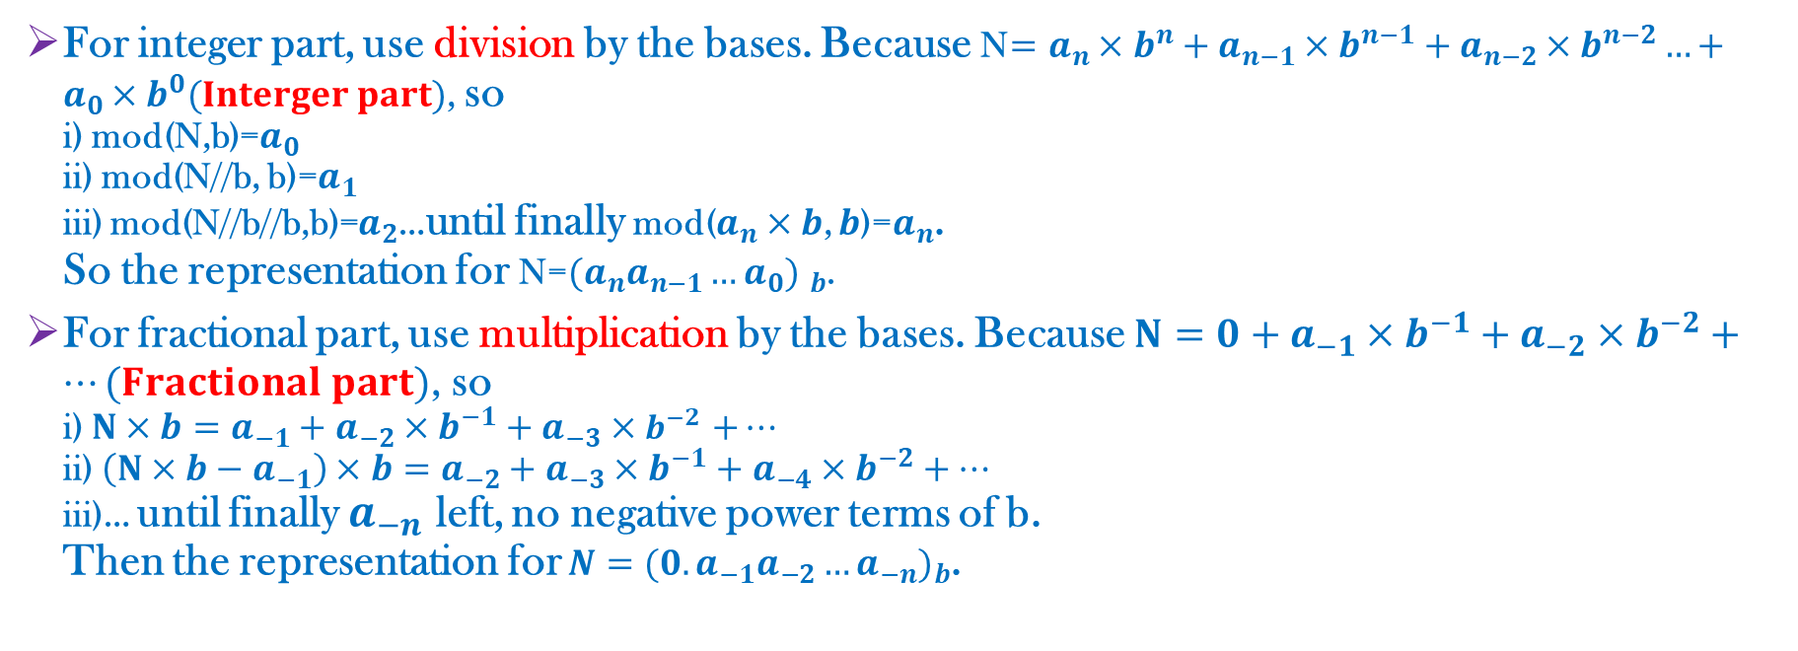
From Decimal to Others
For integer part, use division by the bases. Because N$=a_{n}×b^{n}+a_{n−1}×b^{n−1}+a_{n−2}×b^{n−2}…+a_{0}×b^{0}(Interger part)$, so i) mod(N,b)=$a_{0}$ ii) mod(N//b, b)=$a_{1}$ iii) mod(N//b//b,b)=$a_{2}$…until finally mod($a_{n}×b$, $b$)=$a_{n}$. So the representation for N=${(a_{n}a_{n−1}…a_{0}) }_{b}$.
For fractional part, use multiplication by the bases. Because $N=0+a_{−1}×b^{−1}+a_{−2}×b^{−2}+…(Fractional part)$, so i) $N×b=a_{−1}+a_{−2}×b^{−1}+a_{−3}×b^{−2}$ $+…$ ii) $\left(N×b−a_{−1}\right)×b=a_{−2}+a_{−3}×b^{−1}+a_{−4}×b^{−2}+…$ iii)… until finally $a_{−n}$ left, no negative power terms of b. Then the representation for $N={(0.a_{−1}a_{−2}…a_{−n})}_{b}$.

Slide 11

Practice 3
Year 2019 can also be represented as
$Year {( )}_{16} Year {( )}_{8} Year {( )}_{2}$

Slide 12
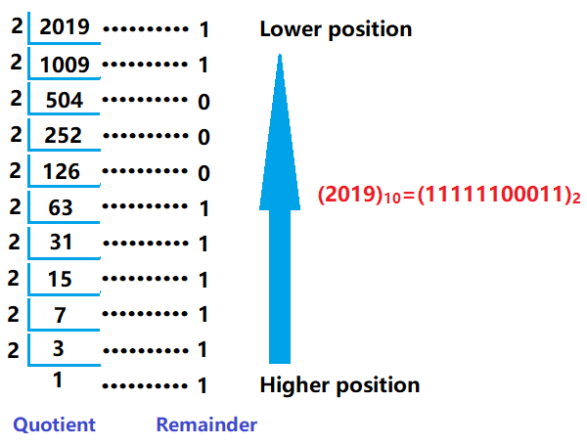
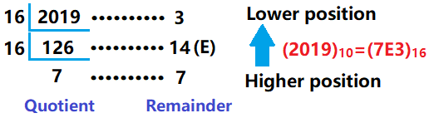
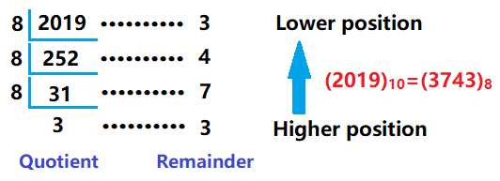
Solution

Slide 13
Practice 4
Convert decimal number 100.96875 into binary, octal and hexadecimal number.

Slide 14
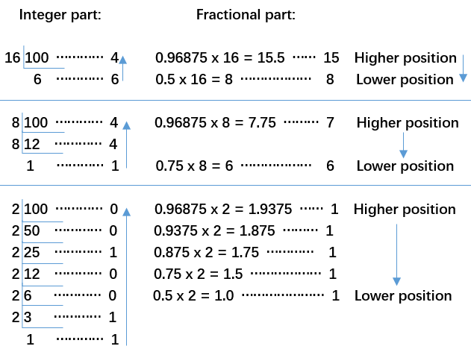
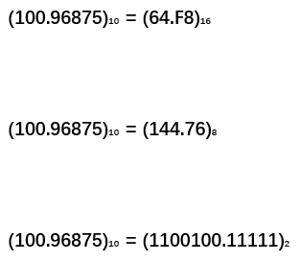
Solution

Slide 15
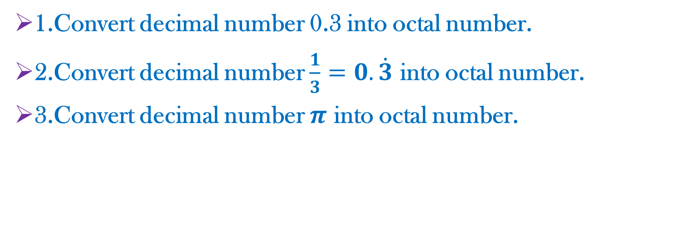
Think!
1.Convert decimal number 0.3 into octal number.
2.Convert decimal number $\frac{1}{3}=0.\dot{3}$ into octal number.
3.Convert decimal number $π$ into octal number.

Slide 16
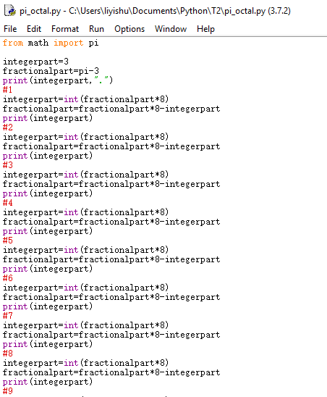
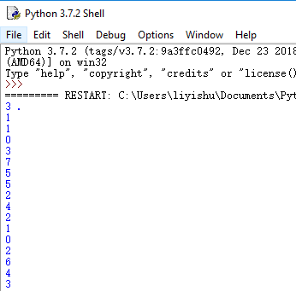

Solution?
$1.{(0.3)}_{10}={=(0.2\dot{3}\dot{1}\dot{4}\dot{6}) }_{8}$(Check by calculating the limit of the corresponding infinite series.)
2$.{(0.\dot{3})}_{10}={(0.\dot{2}\dot{5}) }_{8}$
3$.{(π)}_{10}={(3.1103755242102643…) }_{8}$

Slide 17
Conversion Between Binary, Octal and Hexadecimal
Use one-to-one relationship between i) 3-digit binary number and the symbols of octal number, ii) 4-digit binary number and the symbols of hexadecimal number.
To do conversion between octal and hexadecimal, use binary as a bridge.

Slide 18
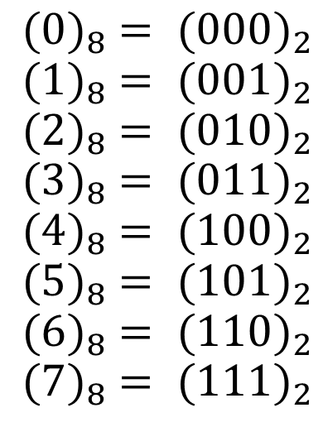
Binary and Octal
The one-to-one relationship between 3-digit binary number and the symbols of octal number?

Slide 19
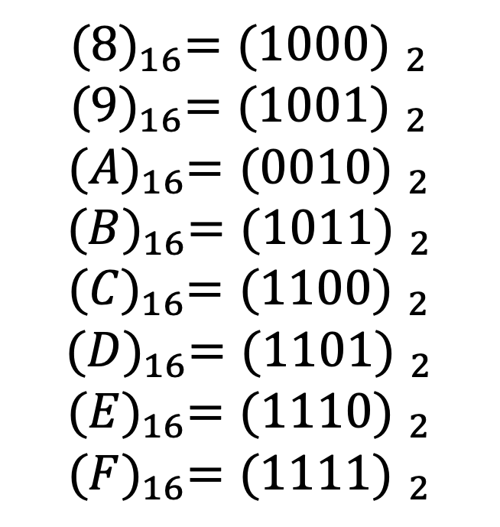
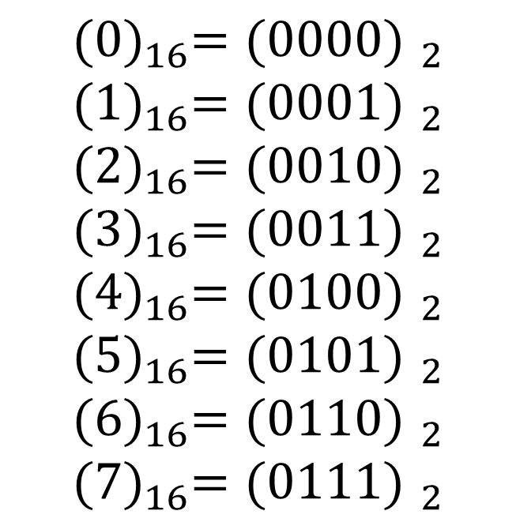
Binary and Hexadecimal
The one-to-one relationship between 4-digit binary number and the symbols of hexadecimal number?
$${(0)}_{16}={(0000) }_{2}$$
$${(1)}_{16}={(0001) }_{2}$$
$${(2)}_{16}={(0010) }_{2}$$
$${(3)}_{16}={(0011) }_{2}$$
$${(4)}_{16}={(0100) }_{2}$$
$${(5)}_{16}={(0101) }_{2}$$
$${(6)}_{16}={(0110) }_{2}$$
$${(7)}_{16}={(0111) }_{2}$$
$${(8)}_{16}={(1000) }_{2}$$
$${(9)}_{16}={(1001) }_{2}$$
$${(A)}_{16}={(0010) }_{2}$$
$${(B)}_{16}={(1011) }_{2}$$
$${(C)}_{16}={(1100) }_{2}$$
$${(D)}_{16}={(1101) }_{2}$$
$${(E)}_{16}={(1110) }_{2}$$
$${(F)}_{16}={(1111) }_{2}$$

Slide 20
Practice 5
1.Convert binary number 10100101.01011 to octal and hexadecimal number respectively.
2.Convert octal number 7654.123 to hexadecimal number.

Slide 21
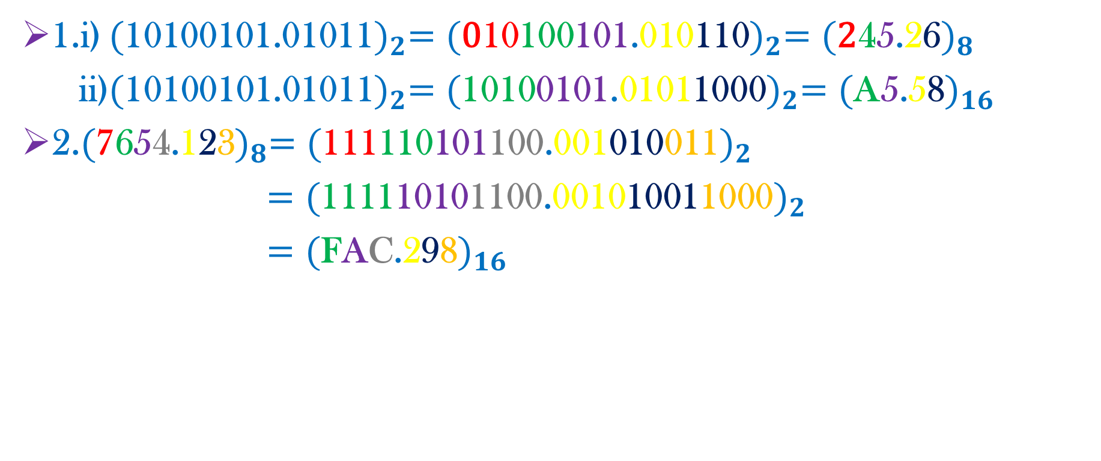
Solution
1.i) ${(\text{10100101.01011})}_{2}={(\text{0}\text{10}\text{100}\text{101}\text{.}\text{010}\text{11}\text{0})}_{2}={(\text{2}\text{4}\text{5}\text{.}\text{2}\text{6})}_{8}$
ii)${(\text{10100101.01011})}_{2}={(\text{10}\text{10}\text{0}\text{101}\text{.}\text{0101}\text{10}\text{00})}_{2}={(\text{A}\text{5}\text{.}\text{5}\text{8})}_{16}$
2.${(\text{7}\text{6}\text{5}\text{4}\text{.}\text{1}\text{2}\text{3})}_{8}={(\text{111}\text{110}\text{101}\text{100}\text{.}\text{001}\text{010}\text{011})}_{2}$
${=(\text{111}\text{1}\text{10}\text{10}\text{1}\text{100}\text{.}\text{001}\text{0}\text{10}\text{01}\text{1000})}_{2}$
${=(\text{F}\text{A}\text{C}\text{.}\text{2}\text{9}\text{8})}_{16}$

Slide 22
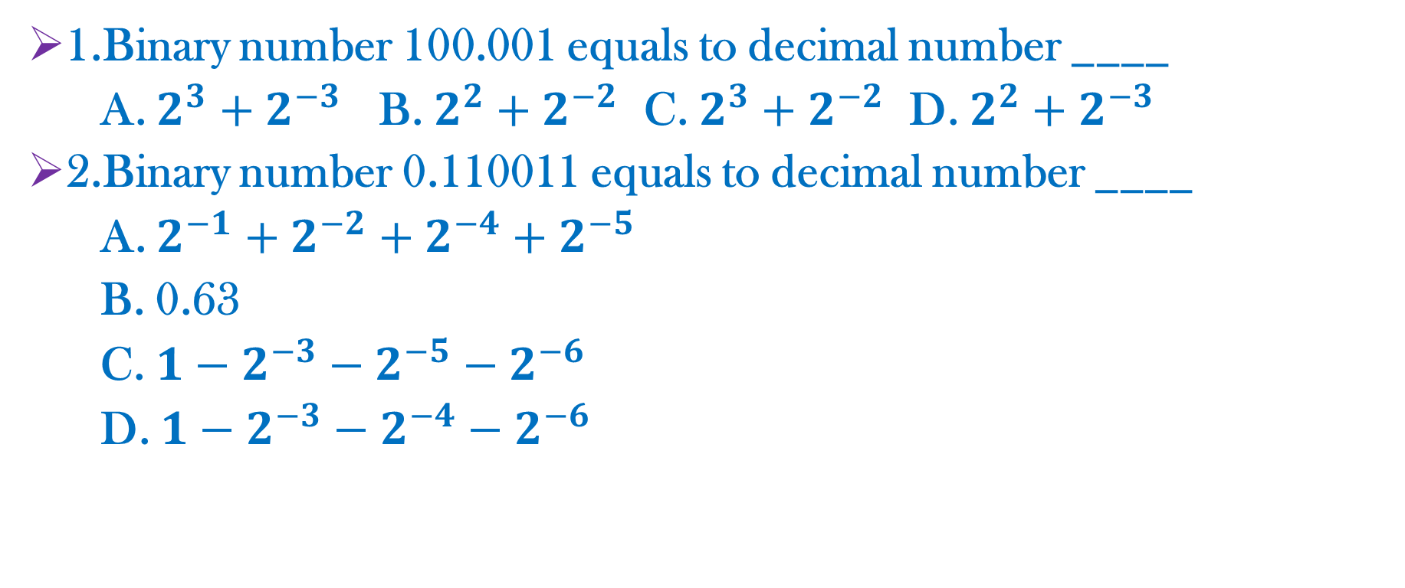
Practice 6
1.Binary number 100.001 equals to decimal number ____
A. $2^{3}+2^{−3}$ B. $2^{2}+2^{−2}$ C. $2^{3}+2^{−2}$ D. $2^{2}+2^{−3}$
2.Binary number 0.110011 equals to decimal number ____
A. $2^{−1}+2^{−2}+2^{−4}+2^{−5}$
B. 0.63
C. $1−2^{−3}−2^{−5}−2^{−6}$
D. $1−2^{−3}−2^{−4}−2^{−6}$

Slide 23

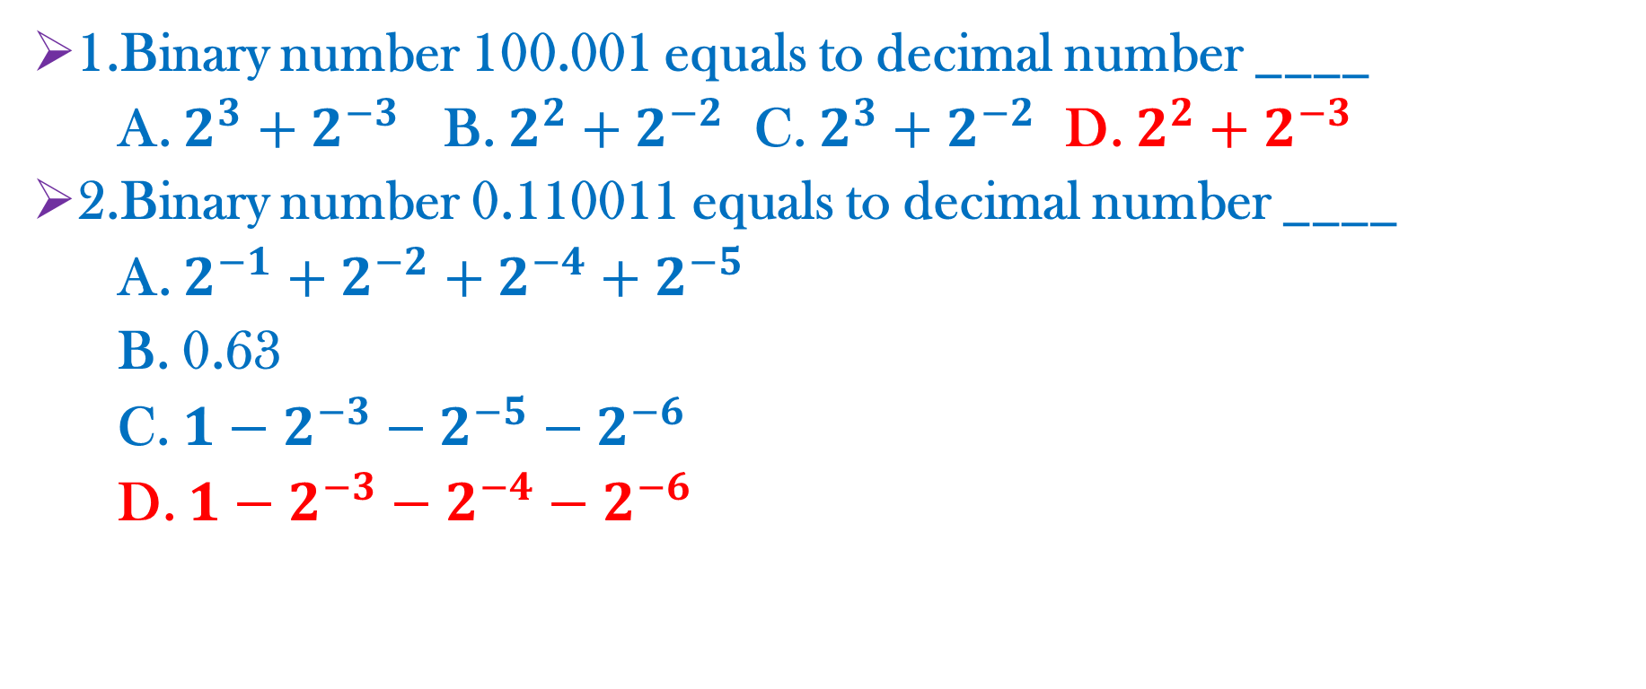
Solution
1.Binary number 100.001 equals to decimal number ____
A. $2^{3}+2^{−3}$ B. $2^{2}+2^{−2}$ C. $2^{3}+2^{−2}$ D. $2^{2}+2^{−3}$
2.Binary number 0.110011 equals to decimal number ____
A. $2^{−1}+2^{−2}+2^{−4}+2^{−5}$
B. 0.63
C. $1−2^{−3}−2^{−5}−2^{−6}$
D. $1−2^{−3}−2^{−4}−2^{−6}$
$$0.110011$$
$$+ 0.001101$$
$$1.000000$$

Slide 24
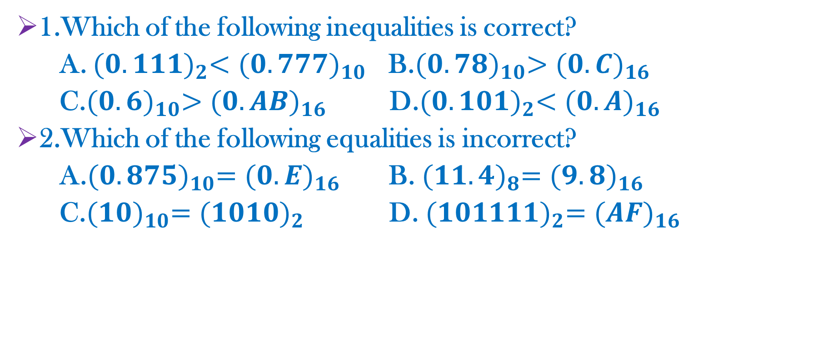
Practice 7
1.Which of the following inequalities is correct?
A. ${(0.111)}_{2}<{(0.777)}_{10}$ B.${(0.78)}_{10}>{(0.C)}_{16}$
C.${(0.6)}_{10}>{(0.AB)}_{16}$ D.${(0.101)}_{2}<{(0.A)}_{16}$
2.Which of the following equalities is incorrect?
A.${(0.875)}_{10}={(0.E)}_{16}$ B. ${(11.4)}_{8}={(9.8)}_{16}$
C.${(10)}_{10}={(1010)}_{2}$ D. ${(101111)}_{2}={(AF)}_{16}$

Slide 25
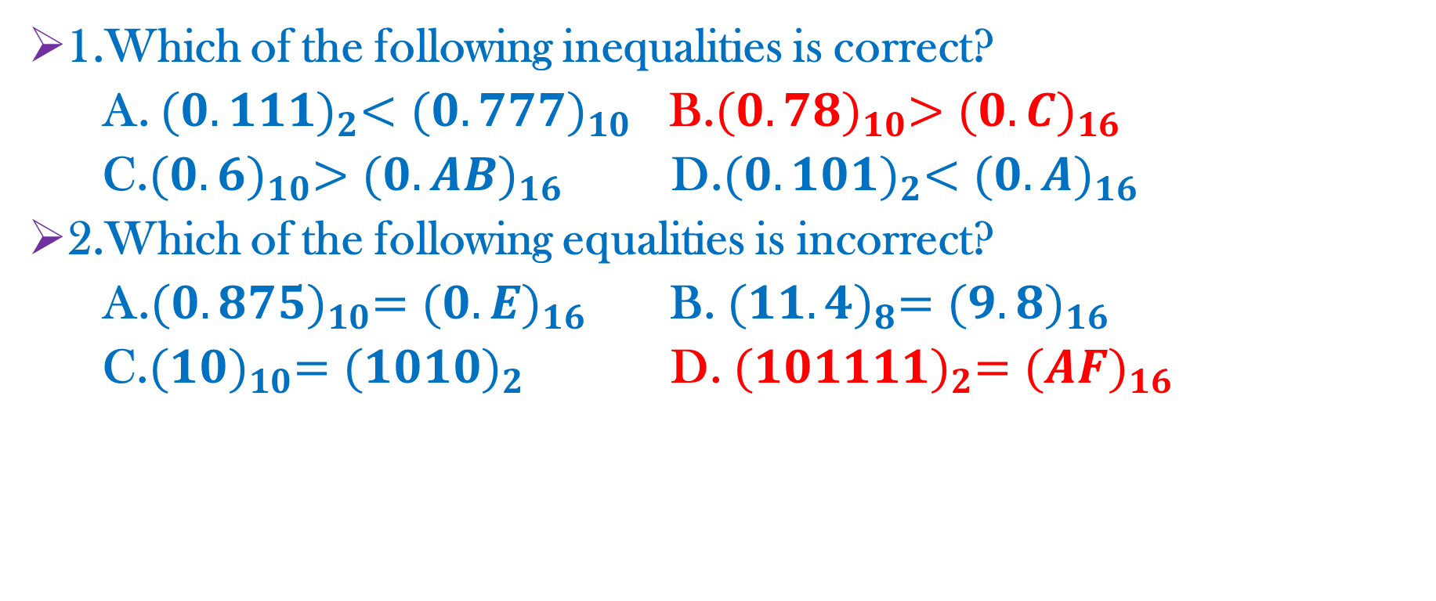
Solution
1.Which of the following inequalities is correct?
A. ${(0.111)}_{2}<{(0.777)}_{10}$ B.${(0.78)}_{10}>{(0.C)}_{16}$
C.${(0.6)}_{10}>{(0.AB)}_{16}$ D.${(0.101)}_{2}<{(0.A)}_{16}$
2.Which of the following equalities is incorrect?
A.${(0.875)}_{10}={(0.E)}_{16}$ B. ${(11.4)}_{8}={(9.8)}_{16}$
C.${(10)}_{10}={(1010)}_{2}$ D. ${(101111)}_{2}={(AF)}_{16}$

